Slide 1
Getting started with X.commerce on Android Platform
Praveen Alavilli Developer Evangelism, Tools & Docs

Slide 2
What we will cover ?
X.commerce
M-Commerce
In-App Payments w/ PayPal
Enhancing User Experience
Product Discovery w/ RedLaser
Personalization w/ PayPal Access

Slide 3
X.commerce empowers developers
to create the future of commerce!

Slide 4

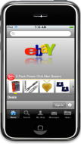



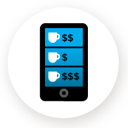
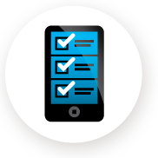





Consumers Shop Differently with Technology
Buy in aisle
Marketing & referrals
In-store price
comparison
Promotions & discounts
Mobile
payment
Research online, find in-stock

Slide 5

Megatrends Changing Commerce
Mobile
Local
Social
Digital
110011
010101
101010

Slide 6
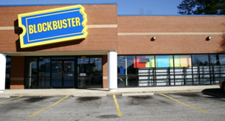
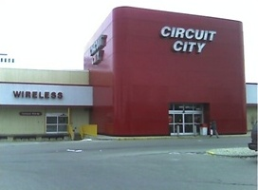
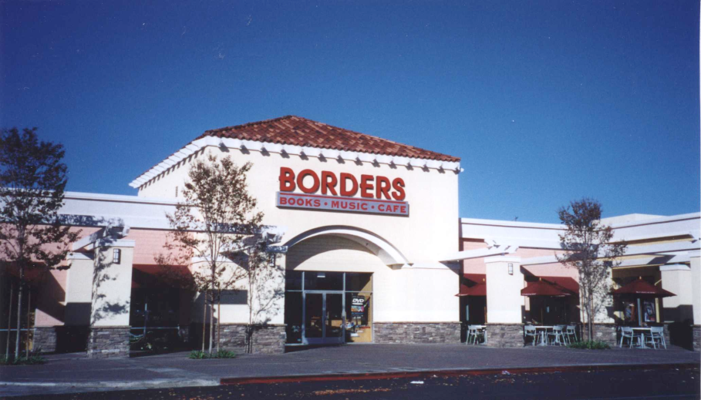
Merchants Are Struggling to Keep Up

Slide 7
Opportunity IS HUGE
Global Commerce 2013E = ~10T
Global Commerce 2010YE = ~8T
+
Online $600B
+
Web enabled offline $3T
Offline $4.5T
-
Sources: Forrester, IDC, Internal Estimates, Proprietary Model
Online refers to TCV$ earned via online channels
Web-Enabled Offline refers to TCV$ earned via offline channels but were influenced by a website
Offline refers to TCV$ earned via offline channels
Notes:
In the demo we’ll show you how to

Slide 8

What’s the Problem?
$
$
$
Reach
Integration
Collaboration
Merchants
Developers
Notes:
Keep pace with innovation
Integrate once, distribute anywhere
Leverage network effect

Slide 9
Empowering You
One-stop Shop
Integration Framework
Participant-driven

Slide 10




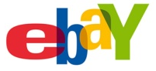






One-stop Shop
Consumer
Products
Your Consumer Services and Apps
Merchant
Products
Your Carts
Your Apps
Platform
Products
X.commerce Fabric
Capabilities
Your Capabilities

Slide 11
One-stop Shop
Consumer
Products
Your Consumer Services and Apps
Marketplace with
97 million
active users
worldwide
Wallet Provider with 100 million active users worldwide
Leading Edge Local Search Provider
Your Carts
Your Carts
Your Apps
Merchant
Products
Your Apps
Platform
Products
X.commerce Fabric
Capabilities
Your Capabilities

Slide 12
One-stop Shop
Consumer
Products
Your Consumer Services and Apps
Your Carts
Your Apps
Merchant
Products
Your Apps
Leading Provider for World’s Premier Brands & Retailers
100K+ Merchants
5K Downloads Daily
Platform
Products
X.commerce Fabric
Your Capabilities
Capabilities
Your Capabilities

Slide 13

Integration Framework
Point-to-Point Integrations
Re-use Model
Merchants
Capabilities
Merchants
Capabilities
Merchant: easy adoption of new capabilities, low switching costs
Developer: no barriers to entry, easy on-boarding of customers

Slide 14

What is a Capability? Technology and/or service that solves a business problem
Marketplace
Catalog
Search
List
Pricing
Offer
$
Ads
Messages
Marketplace
Coupons
Payment
Fulfillment
Customer Service

Slide 15
Multi-CHannel
An Example

Slide 16
What is a Channel Sales outlet or a means to drive traffic to a sales outlet
Catalog
Catalog
http://www
Catalog
Catalog
Online Store
Offline Store
Marketplace
Comparison Shopping Engine
SALE
SEM
Social Media
Display Ads
Affiliate

Slide 17


Channel Experience Today
Integration effort and tracking new channels
Opportunities for innovation
Opportunities for services
Barriers to entry
Dependent on others
Unified view of channel performance
Merchants
Developers
Channel Owners

Slide 18
Example: Multi-channel
Off-the-shelf Carts
Magento
Custom Carts
Other Apps
X.commerce Fabric
Online Store
Offline Store
eBay
Marketplace
Comparison Shopping Engine
SEM
Social Media
SEO
Display Ads
Affiliate
Analytics
…
Kenshoo
Terapeak
…

Slide 19
Super-Awesome Value for Merchants
Reach more customers
Faster time-to-market through ease of use
Future-proof
Insights through data and analysis
Trusted applications and developers

Slide 20
Super-Awesome Value for Developers
Reach more merchants
Ease of development with standards and hosting
Monetize better through technology and services distribution
Data for targeting and personalization

Slide 21
Our Platform, Your Imagination!
Consumer
Products
Your Consumer Services and Apps
Your Consumer Services and Apps
Your Carts
Your Carts
Your Apps
Merchant
Products
Your Apps
x.com/developers
Platform
Products
X.commerce Fabric
Your Capabilities
Capabilities
Your Capabilities

Slide 22
Mobile Commerce

Slide 23
M-commerce is exploding
Apps
Remote
Global Mobile Apps Revenues ($B)
eBay reached ~2B+ in 2010
Amazon reached $1B in last year
Japan showing the way with Rakuten mcommerce volume @ 20% of total
Source: Gartner (January, 2010)
Notes:
# developers?
# consumers? And what buying?

Slide 24
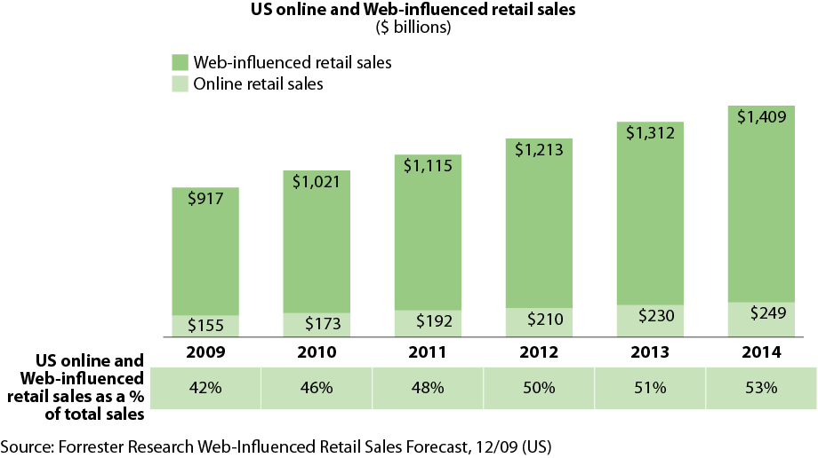
Online and Offline are blurring

Slide 25
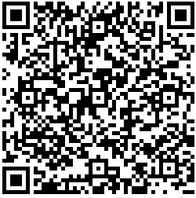
M-commerce is also expanding
Moving offline
New use cases are extending this field beyond digital content and e-commerce:
Selling merchandise in games
LBS and coupons
Comparison shopping
Private and time sensitive sales
Ticketing
Mobile driving store traffic with daily deals

Slide 26
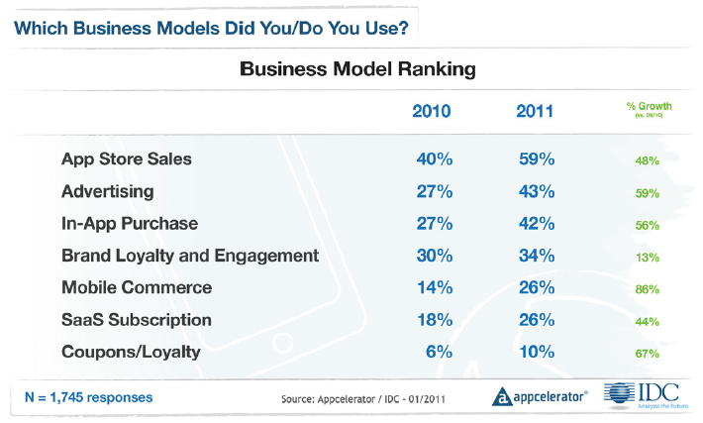
PREFERRED BUSINESS MODELS

Slide 27
PayPal: Payments Anywhere – Anyhow !
Credit Cards
eComm
mComm
Chained
Payments
Mobile Payments
P2P
Payments
Disbursements
Utility Payments
Social Payments
SaaS
Payments
Delayed
Payments
Parallel
Payments
Digital Goods
Business
Payments
Embedded
Payments
Subscriptions
eWallet
Affiliate
Payments
Preapprovals
Refunds

Slide 28
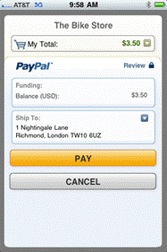
PayPal’s Mobile Payment Library
Making it easier for developers
Designed to be integrated in less than 10 minutes
No need to code payment UI
Don’t need to worry about sensitive financial info
More convenient than always typing credit card
Can use existing account information
Physical goods and services
In-app purchase
Simple, Chained, Parallel, and Pre-approved payments
Supports Android 1.5 and above (and iOS 3.0 and above)
Making it better for consumers
A growing feature set

Slide 29
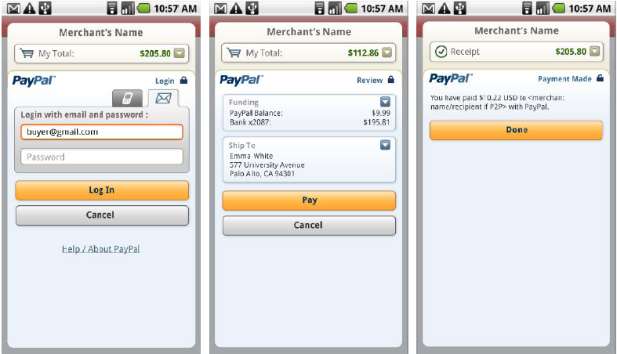
Simple in-app Payment Demo
Notes:
MPL and MEC

Slide 30
Google or PayPal ?
Google
PayPal
Digital goods
Virtual currencies
Premium features
(Digital content subscriptions)
Physical goods
P2P payments
Service payments
e/m-commerce
Donations
Crowd Sourcing
Subscriptions
SaaS Payments
Non-traditional commerce
Other Providers :
Use cases vary, PCI Compliance, etc.

Slide 31
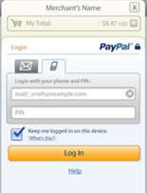
PayPal in-app – component diagram
Your Application
Your Server
(Optional)
Your Activity
onCreate(){
…
getCheckoutButton(…);
}
onClickListener() {
…
startActivityForResult(…);
}
onPaymentSucceeded() {
…
}
onPaymentFailed(){
…
}
onPaymentCanceled() {
…
}
onActivityResult(){
…
}
Item delivery
Purchase data
PayPal Checkout Activity
Instant Payment
Notifications
(Optional)
PayPal Server
User Wallet
Fraud/Risk
Transaction data

Slide 32
Building an App with Mobile Payment Library
Step 1: Download the library and add it to your app
Step 2: Update AndroidManofest.xml
Step 3: Initialize your library
Step 4: Generate PayPal Button w/ onClickListener
Step 5: Start Payment Activity using Checkout Intent
Step 6: Handle result from library.

Slide 33



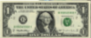

Chained, Parallel and Preapproved Payments
$10
$100
$100
$10
$40
$40
Primary
$50
Parallel Payment
$50
Chained Payment
Pre Approval
C

Slide 34
Advanced Functionality
ResultDelegate
Chained, Parallel and Preapproved Payments
Dynamic Amount Calculation
Instant Payment Notification
Refunds
Transaction Search and Details

Slide 35
Enhancing consumer experience: product discovery

Slide 36
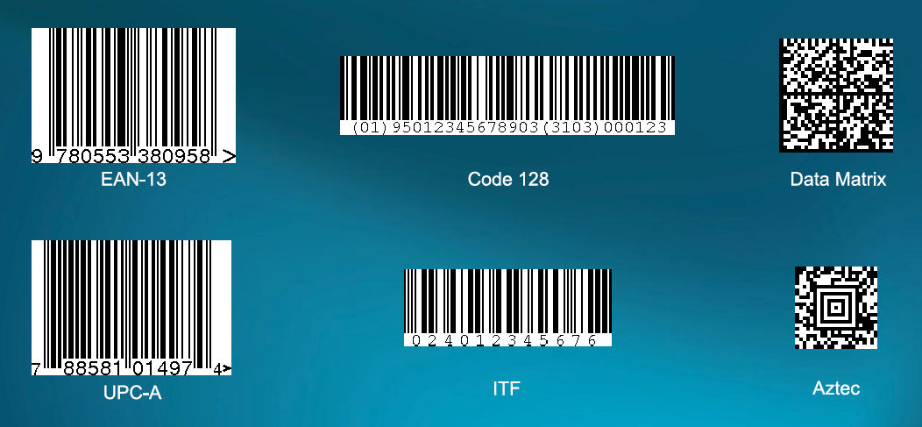
Code Symbologies
and many more…

Slide 37
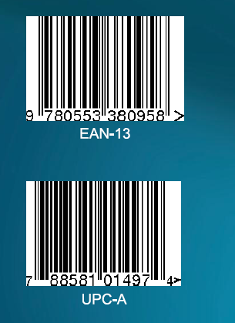
Product Barcodes
Generally unique identifiers for products
Standards maintained by GS1
Increasingly important for product discovery

Slide 38
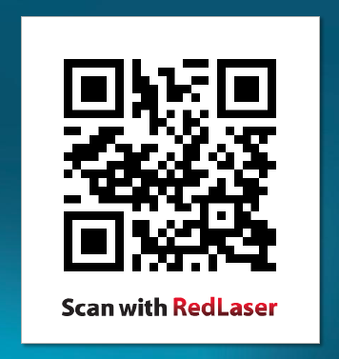
QR Codes
Created by Denso Wave in 1994
Encode up to 4,296 alphanumeric characters (varies with implementation)
Combine with standards to encode URLs, contacts, events, etc.

Slide 39
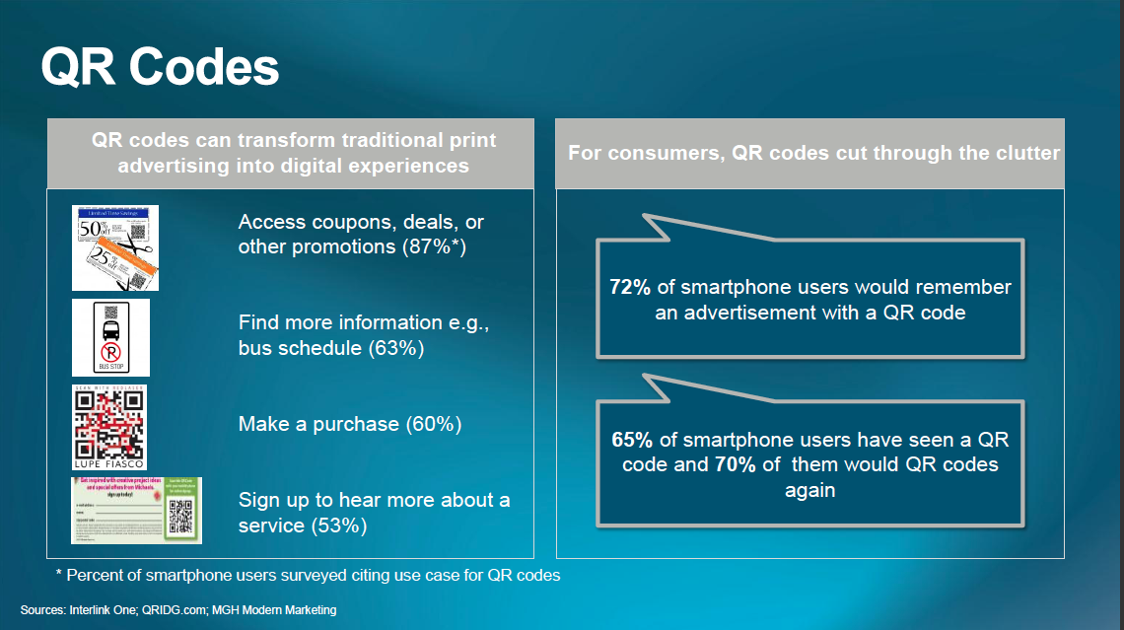

Slide 40

? I have that app…
Over 10 million downloads
Used throughout eBay mobile’s family of apps
Hundreds of partner companies as well
Wal-Mart
Toyota
Chegg
Groupon
Fast, simple integration
Notes:
Used in: eBay Core for iPhone and iPad, Half.com, Shopping.com, eBay Selling, eBay Motors, Milo, Where.com, coming soon to StubHub and eBay Classifieds.

Slide 41
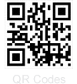
What Does It Do?
Yes, it scans barcodes
Multiple barcodes. At once.
Works on all iOS/Android devices with cameras.
QR Codes are fully supported

Slide 42
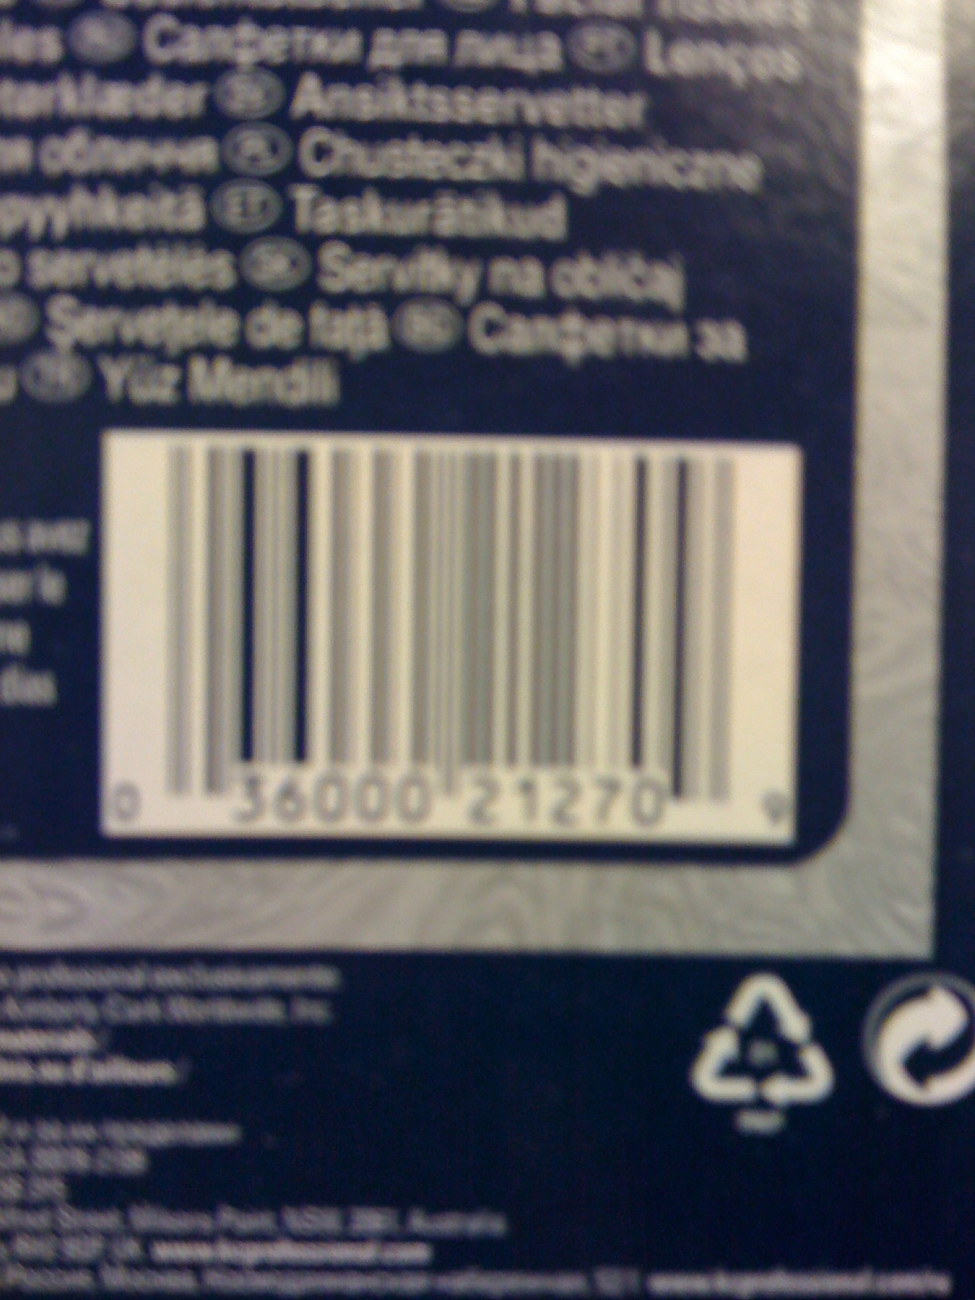
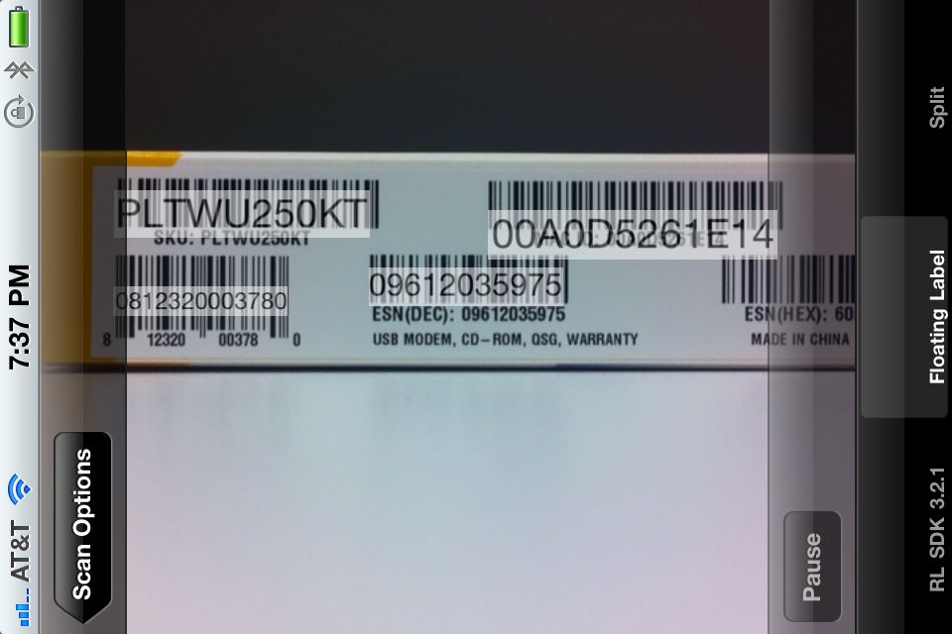
What Does It Do?
Notes:
On the left, this is an actual picture of what the camera on the iPhone 3G sees.
It’s very blurry.
On the right, this is our test app, showing multiple barcodes being recognized at once, with floating labels.

Slide 43
What RedLaser Does Not Do
RedLaser is not a web service. We do not provide a UPC database for external queries.
The SDK tells your app what it saw; it is up to you to interpret it.

Slide 44
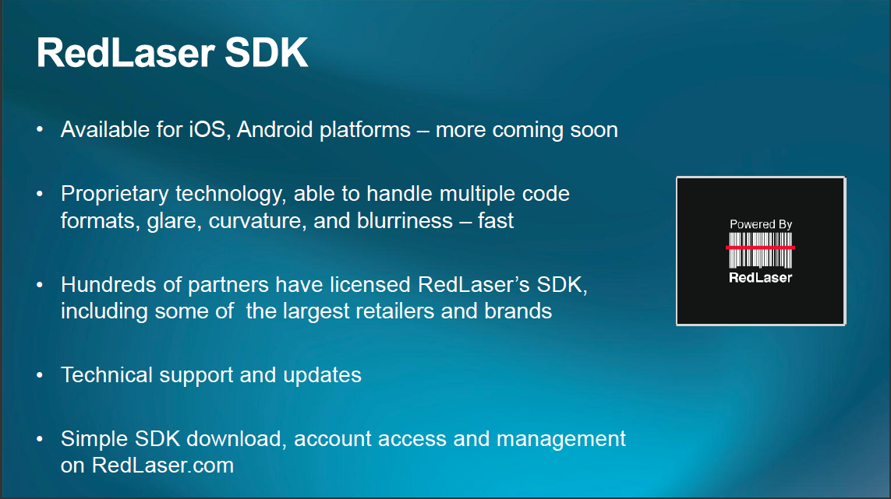

Slide 45
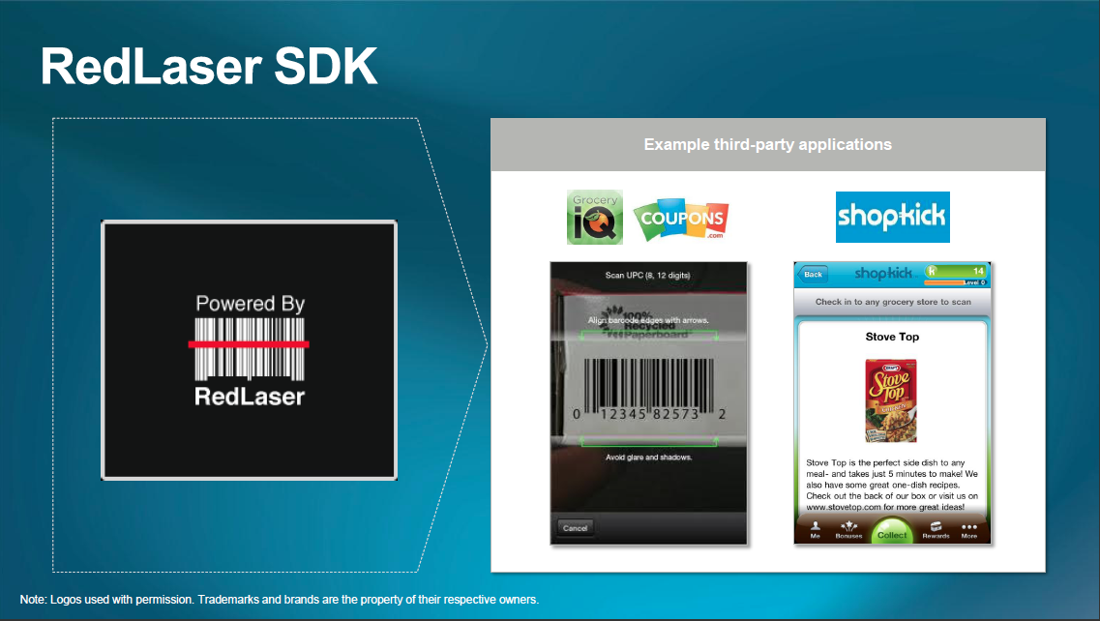

Slide 46
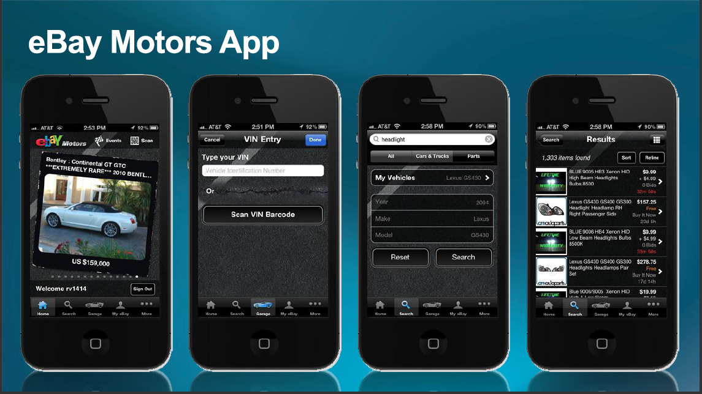

Slide 47
Getting started with SDK
Download SDK
Import the libs
Create a new Activity that extends BarcodeScanActivity to customize your scans
Start activity and handle the result.
Development/Evaluation free

Slide 48
Enhancing consumer experience - Personalization

Slide 49
Identity in Commerce
Build extensible applications off of real user history and habits
Use purchasing history to define a whole new level of trust
Deliver an integrated payment system directly into user identity
Make it easier for your users to buy from you!
Socializing the buying experience

Slide 50
Why should we care?
23 % of customers abandoned carts when asked to register. (Forrester)
45 % left a site when they couldn’t remember their password. (Blue Inc)

Slide 51
Why PayPal?
Access to 100M+ active, verified consumers
45M events per day processed
600M credit cards
600M email addresses

Slide 52
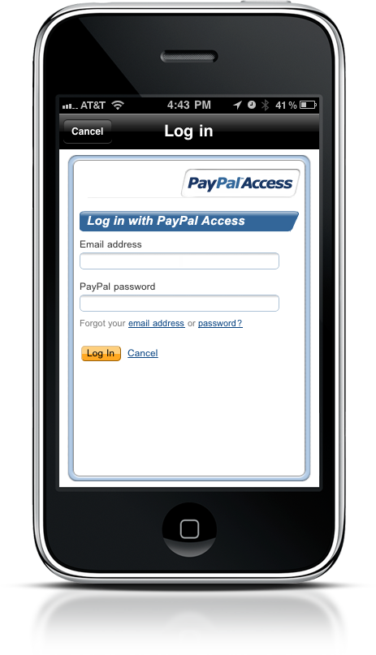
PayPal Access Mobile Web – OAuth Beta
Overview
OAuth 2.0
Beta experience
Same consistent experience
Details
Visit x.com/identity to integrate
Currently does not support PayPal Mobile + PIN login

Slide 53
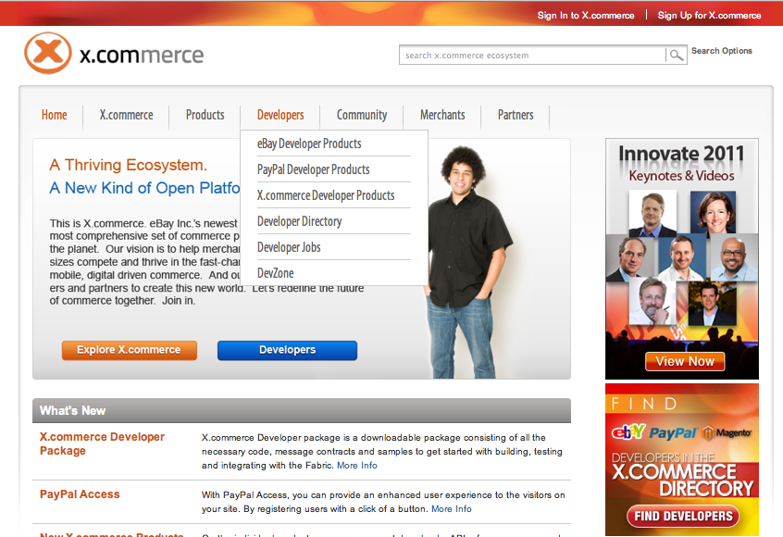
Where to find more info?

Slide 54
?
https://www.x.com
Praveen Alavilli @ppalavilli

